Slide 1
3D Model Creation from Series of Images
Casey Conrad, Logan Hunter, Joanna Stecz

Slide 2
Intro to team and project
Casey Conrad
Logan Hunter
Joanna Stecz
Our project will take a series of images as input
Produce a 3D model of the space
Resulting model will be displayed in an interactive environment
Model and annotations can be saved to be opened in other modeling software

Slide 3
promised deliverables
UML Diagrams and Documentation for the Project - Updated
The software application to produce 3D models from a series of images
Clustering images by subject to create single subject models
Structure from Motion and Linear Perspective to reintroduce depth
3D interactive environment to annotate and view the model
Encoding the model to a format that is commonly used in the target domains

Slide 4
timeline
Milestone | Expected Completion Date | Completion Date
UML Diagram | 2/05/2022 | 2/05/2022
Software to Group Images by Subject | 2/14/2022 | 2/15/2022
Structure From Motion and Linear Perspective Algorithms for Single Subject Clusters | 2/28/2022 | 4/30/2022*
Software to remove nonconstant elements from images | 3/28/2022 | N/A
Finalization of Backend | 3/28/2022 | 5/1/2022
User Interface Elements | 4/14/2022 | 5/1/2022
Finalization of Project | 4/18/2022 | 5/2/2022
Notes:
First two milestones on time.
Major delays on SFM system, addition of calibration system.
SFM system handles items like people, trees since they shouldn't appear in more than a few images
Ambiguity of multiple timeline elements
Software to remove nonconstant elements: We didn’t need bc structure from motion only would include these if they were in several images in a chain
User can avoid having these nonconstant elements in their images

Slide 5
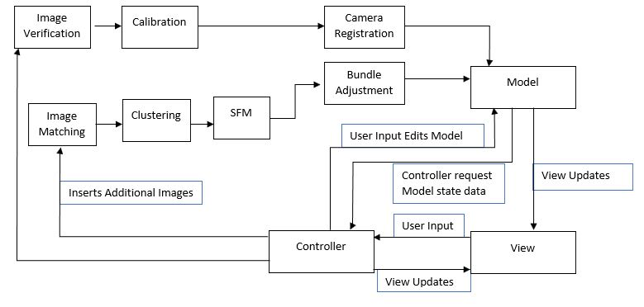
Deliverable #1: Uml Diagram
Minor changes to reflect updated understanding of the problem
Notes:
Note addition of calibration pipe and removal of linear perspective filter

Slide 6

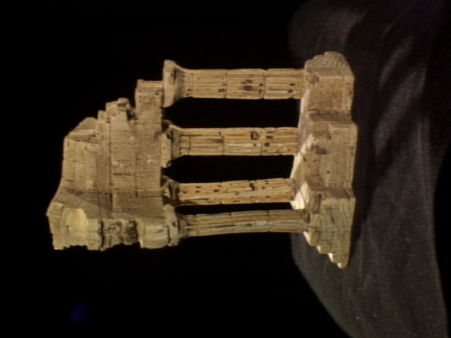
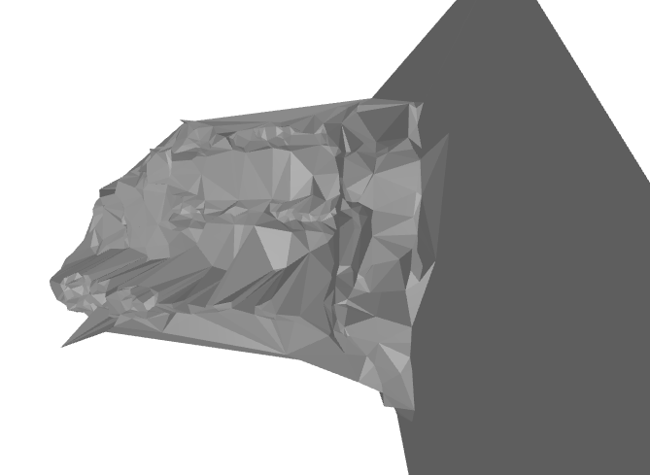
Deliverable #2: Software application to produce 3d models
Clustering images by subject to create single subject models
Structure from Motion to reintroduce depth
Notes:
Note that the model shown was created from the output point cloud, so it assumes that every neighbor should be meshed

Slide 7
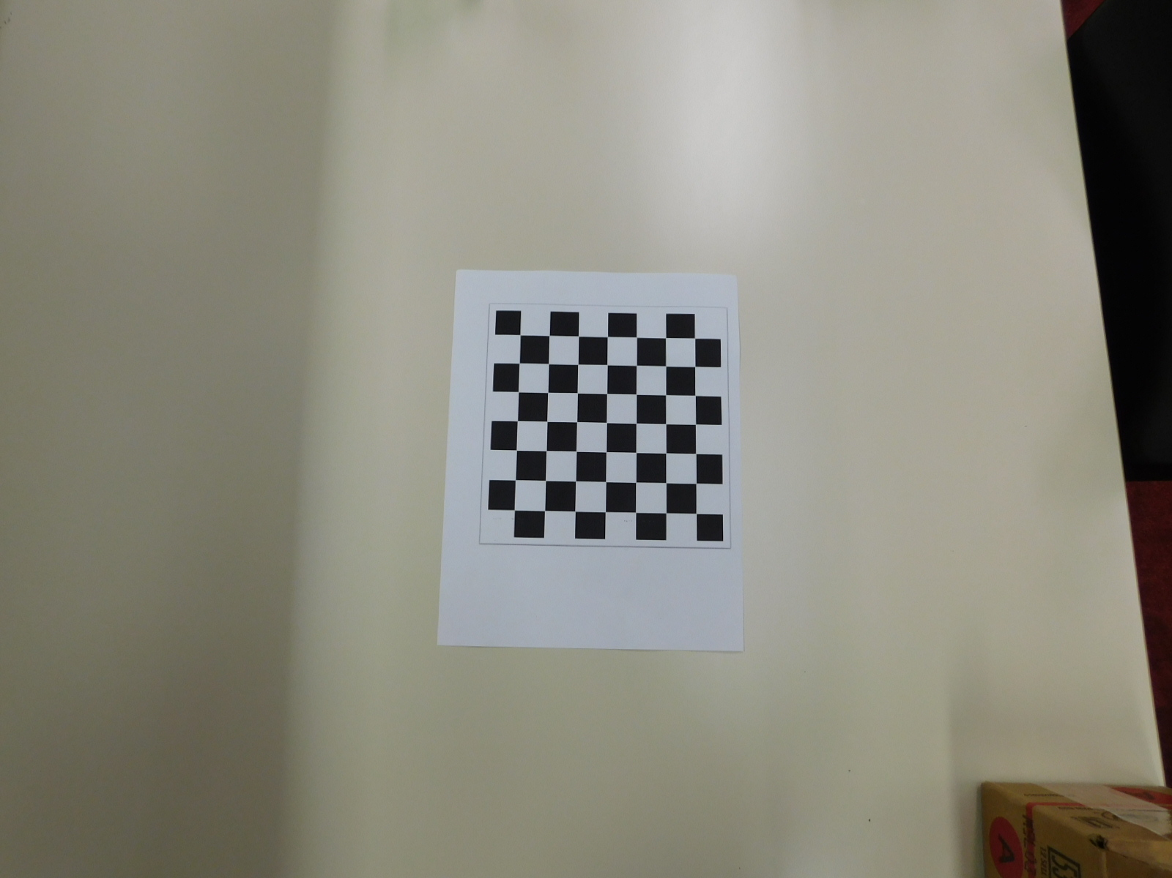
Calibration
Found that the generation of an intrinsic matrix could not be achieved through using the image's EXIF metadata alone.
Developed system to calibrate the users' cameras with a series of images of a printable chessboard pattern, then saves the information to be used in later sessions.
Assumption that all images for a model must be taken using the same camera.
NIKON,COOLPIX B500,4.0,(1200, 1600)
[
]
1.0647e+03 0.0000e+00 7.9064e+02
0.0000e+00 1.0636e+03 6.0505e+02
0.0000e+00 0.0000e+00 1.0000e+00
Notes:
Process of calibration: (At least 10 images must be used)
Identify that every image comes from the same camera – exif data, size
Locate the Chessboard (or circlegird) pattern in each image
Treat the found pixels as image points while knowing the location of the object points is fixed.
Calculate the estimated intrinsic matrix and distortion parameters

Slide 8
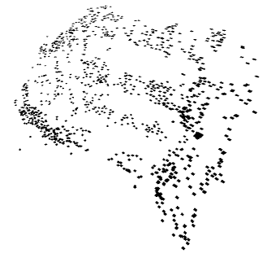
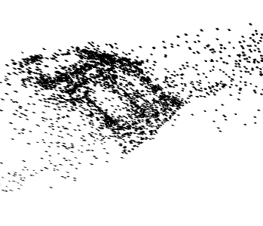
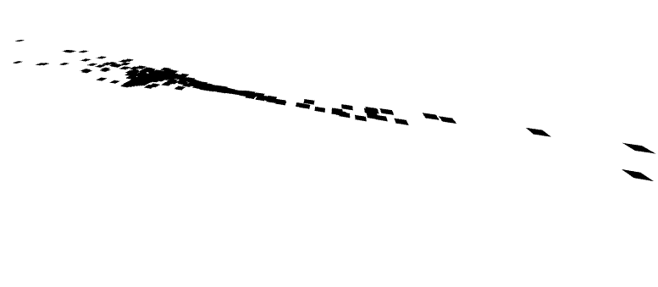
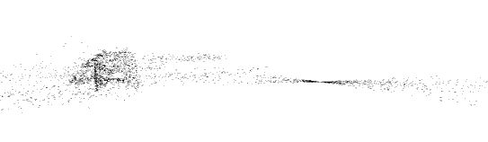
Structure from Motion
Focused exclusively on developing the Structure from Motion algorithm.
Multiple Redesigns to account for shortcomings in algorithms
incremental structure from motion
Images received in order resembling a path around the object
Significant Setbacks to Timeline
Assumption that all images are taken with the same intrinsic matrix
Notes:
Could not implement a linear perspective algorithm in the timeframe
Multiple redesigns as research found elements missing from earlier designs
Utilizes Incremental structure from motion – need to follow a single path around the object
Moving forward: find way to determine the proper bounding box for the model automatically

Slide 9
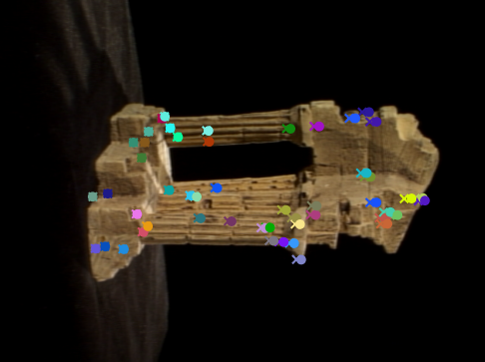
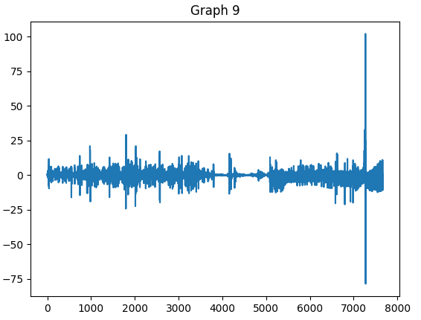
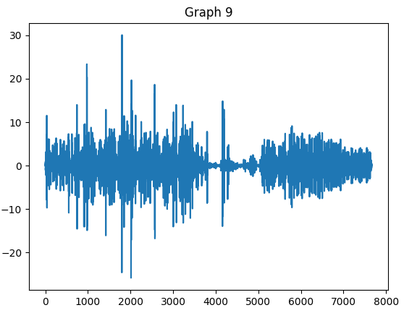
Bundle Adjustment
Process added after the midterm presentation to improve accuracy
Utilizes least-squares optimization to minimize reprojection error.
Notes:
Fig 1. Representation of reprojection of keypoints on an image in the initial pair for temple ring (12) after the initial pair has been triangulated.
Fig 2. Reprojection chart after 9 images have been added to the model for temple ring (Standard Bundle Adjustment Checkpoint).
Fig 3. Reprojection chart after 9 images have been added to the model for temple ring (Mitigating High measured reprojection error).

Slide 10
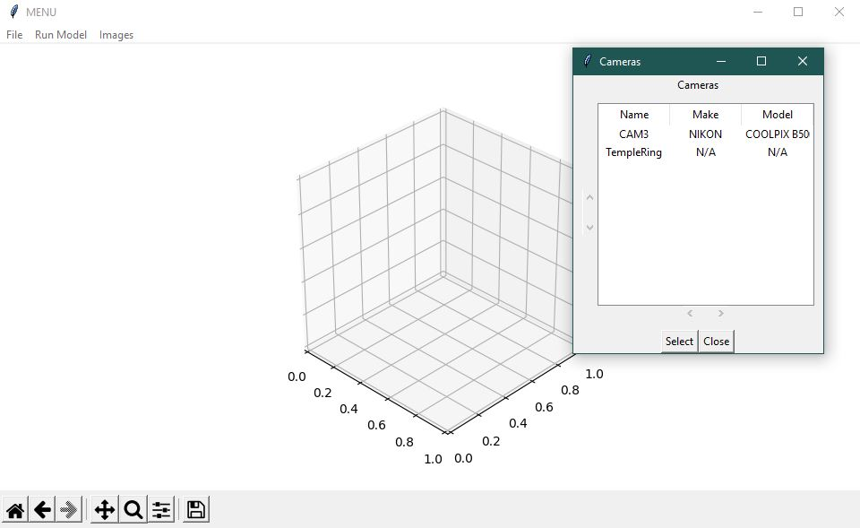
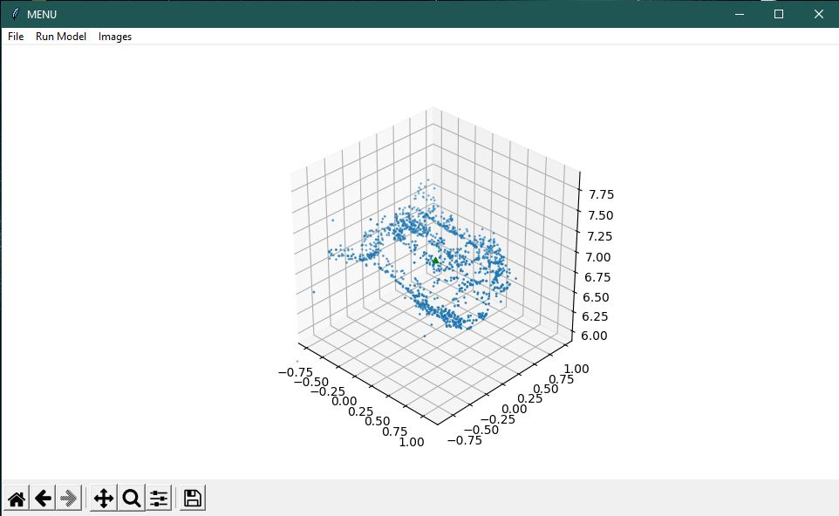
Deliverable #3: 3D interactive environment
Prototyping
Multiple options
Notes:
GUI screenshots,
Difficulty presenting the model

Slide 11
Deliverable #4: Encoding the model
The goal:
Encode the model in a format commonly used in the target domains
Results:
Encoding model to .xyz, .ply, and .pcd as point cloud
Notes:
Simplified by open3d
Only encoded to .xyz, .ply, and .pcd as point cloud
Can implement meshes on the point cloud to encode as .ply, .stl, and .obj meshes
Encoding to other popular options (.cad, .3mf, etc.) will require additional translations

